Slide 1
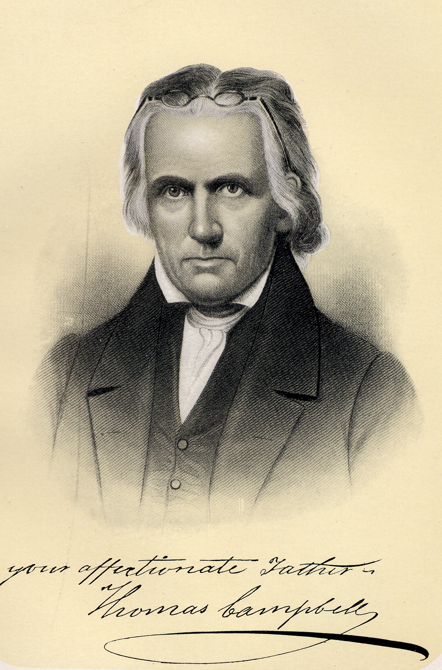
The Thinking of Thomas Campbell as Seen in the Declaration and Address
Notes:
Gary & Teresa Hampton
David Kenney - Theology of three Early Restoration Documents

Slide 2
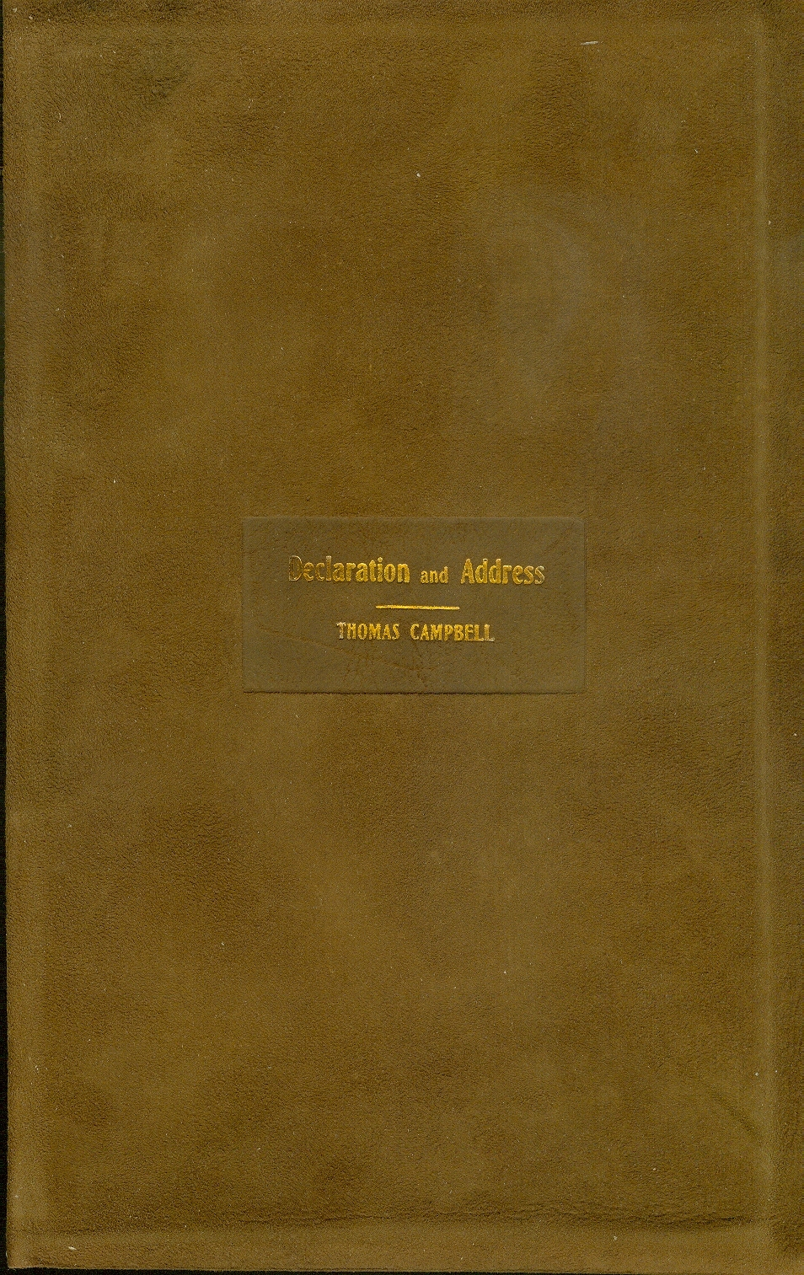
What The Declaration And Address Is And What It Says

Slide 3
The Summer Of 1809
Where: near Washington, Penn.
To: The Christian Association Of Washington
When – September 7, 1809
Declaration – 9 Resolutions – 1,294 words – What we are doing
Address – 13 Propositions – 26,288 words – Appeal to the Assoc. to do it
Bottom Line – A written apologetic for taking the Bible alone for their authority in all religious matters.

Slide 4
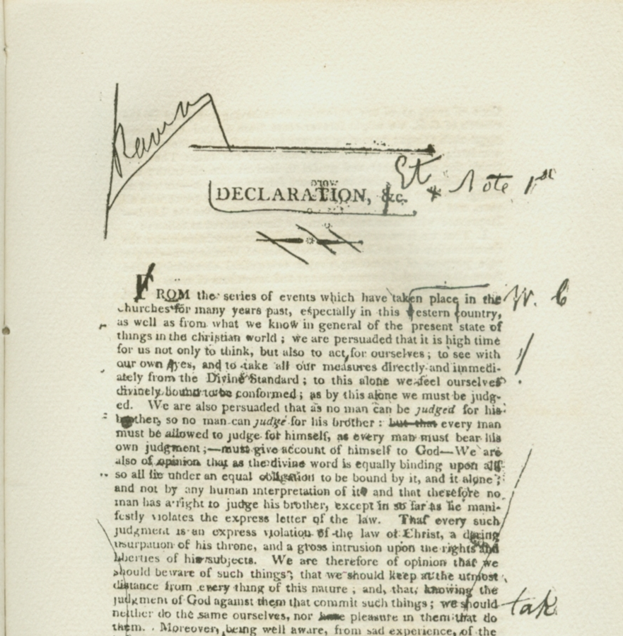
Declaration
“Form ourselves into a religious association under the denomination of the Christian Association Of Washington, for the sole purpose of promoting simple evangelical Christianity, free from all mixture of human opinions and inventions of men.”
We are going to fund it – half-yearly specified sum
Be evangelistic about it – trying to get other groups formed like it.
We are not a Church – but a group of “voluntary advocates for Church reform”

Slide 5
Declaration
“That this Society, formed for the sole purpose of promoting simple evangelical Christianity” and conforming to the “original standard in conversation and doctrine.” In other words = we will do nothing from opinion, only by a “Thus saith the Lord.”
A standing committee of 21 people appointed to transact the business of the Society.
The Society meet at least twice a year, to conduct the business, collect the money.
How the Society meetings will be conducted – starts with a sermon, then other business
That the Society rely totally on Christ as head – no human governing power.”

Slide 6
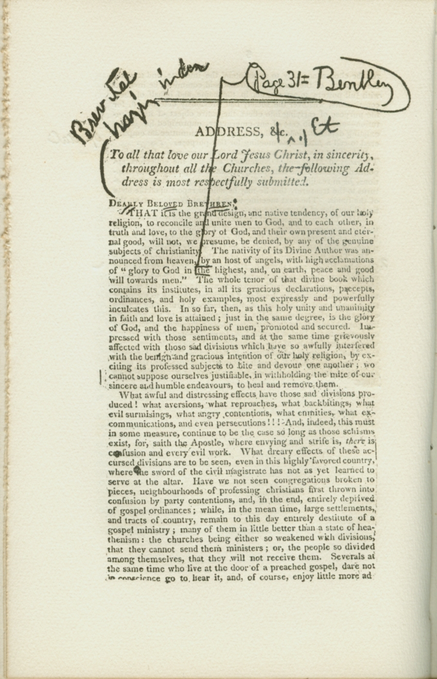
Address
Preceding paragraph to the 13: “Let none imagine that the subjoined propositions are at all intended as an overture toward a new creed or standard for the Church, or as in any wise designed to be made a term of communion; nothing can be further from our intention. They are merely designed for opening up the way, that we may come fairly and firmly to original ground upon clear and certain premises, and take up things just as the apostles left them; that thus disentangled from the accruing embarrassments of intervening ages, we may stand with evidence upon the same ground on which the Church stood at the beginning. Having said so much to solicit attention and prevent mistake, we submit as follows:”

Slide 7
Address
“PROP. 1. That the Church of Christ upon earth is essentially, intentionally, and constitutionally one; consisting of all those in every place that profess their faith in Christ and obedience to him in all things according to the Scriptures, and that manifest the same by their tempers and conduct, and of none else; as none else can be truly and properly called Christians.”

Slide 8
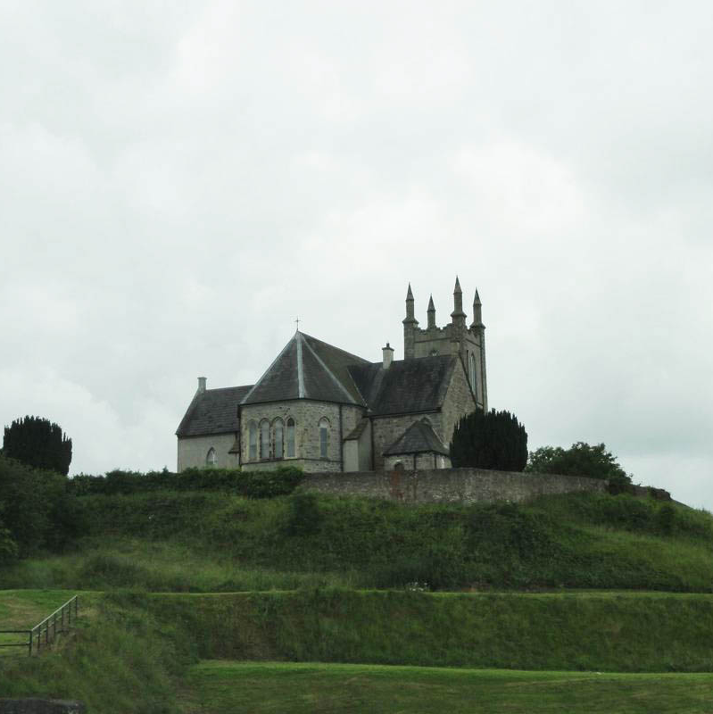
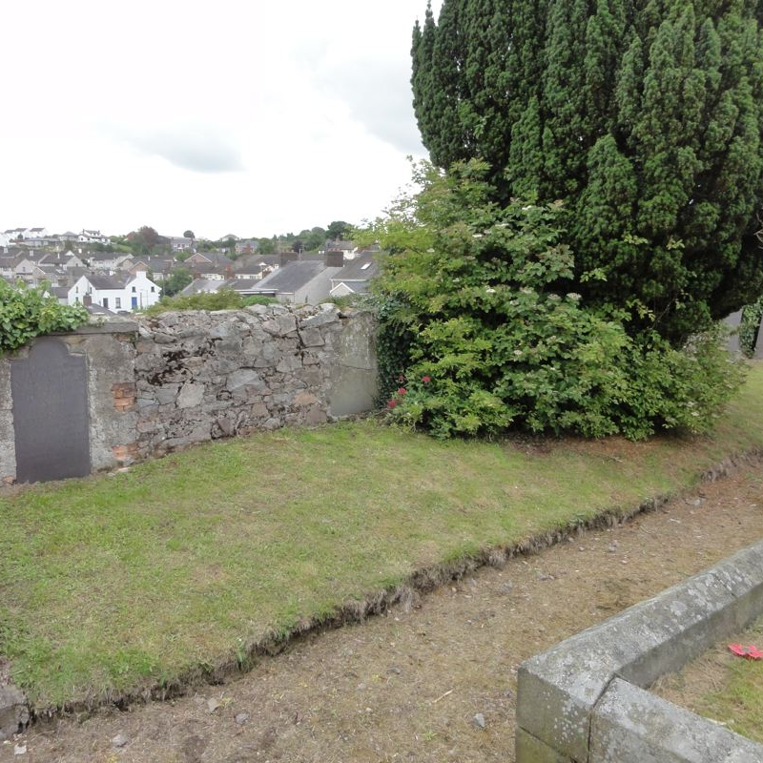
Thinking That Brought Thomas Campbell To Write The D & A
St. Patrick’s
Church of Ireland
At Newry, where
His family is buried
Born in Newry, County Down, Ireland February 1, 1763
His father, Archibald was a Catholic, turned Church of England — Said he, “served God according to Act of Parliament”
Grave of Enos Campbell
Family – brother of Thomas
At St. Patricks
Notes:
His father said he “served God according to Act of Parliament”
What this says about the mindset of the day – no separation between church and state. The state was the church and visa-versa.

Slide 9
Thinking That Brought Thomas Campbell To Write The D & A
St. Patrick’s
Church of Ireland
At Newry, where
His family is buried
1783-1786 – attended University of Glasgow, Scotland
1787 – Entered Whitburn Seminary – of Anti-Burgher Seceder Pres. Chur.
1787 – Marries Jane Corneigle (1763-1835), French Huguenot descendant.
1788 – Sept. 12, Alexander born – first of 9 children
Grave of Enos Campbell
Family – brother of Thomas
At St. Patricks
Notes:
Huguenots were French Protestants who held to the Reformed, or Calvinist, tradition of Protestantism. The term has its origin in early-16th-century France. It was frequently used in reference to those of the Reformed Church of France from the time of the Protestant Reformation.

Slide 10
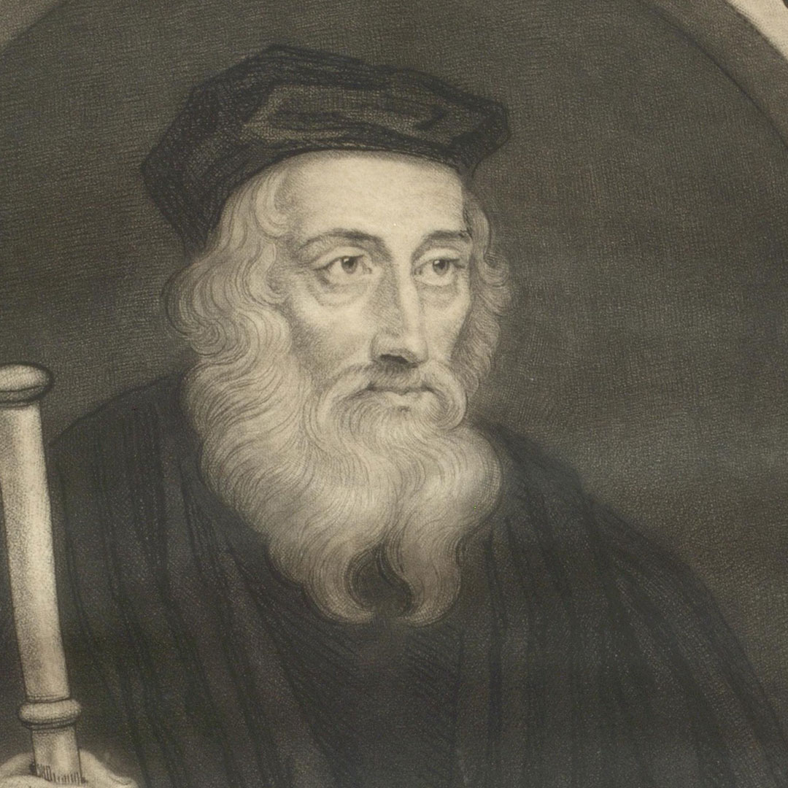
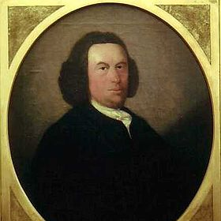
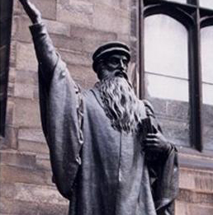
Thinking That Brought Thomas Campbell To Write The D & A
British Isles, a hotbed of reform for over 350 years.
1370s – John Wycliffe, England
1550s-70s – John Knox – Scotland
1720s – John Glas – Dundee, Scotland started a society of 100 people for the purpose of following the Scriptures alone
John Wycliffe 1328-1384
John Glas
1695-1773
John Knox 1510-1572

Slide 11
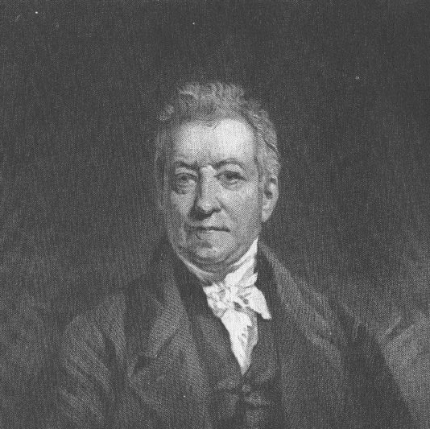
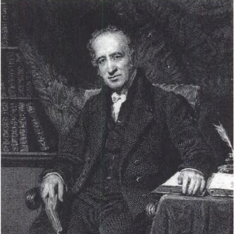
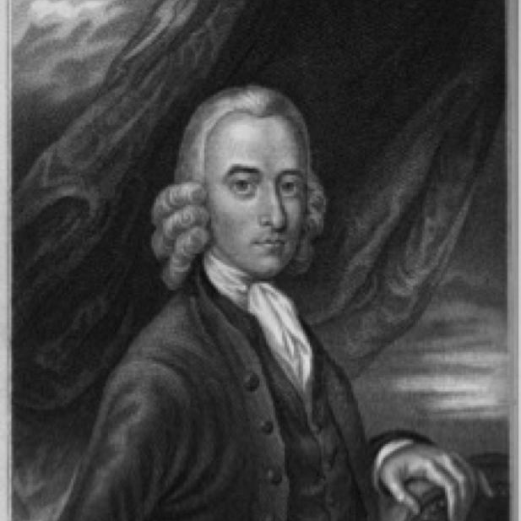
The Battle Over The Grip Of Calvinism
1757 – “Letters on Theron and Aspasio” by Robert Sandeman
By 1800 – British Isles becomes embroiled in controversy between Evangelicals and State Churches
James Haldane 1768-1851
Greville Ewing 1767-1841
Robert Sandeman 1718-1771
Notes:
1755 - James Hervey (1714-1758) a Calvinist minister writes ”Theron And Aspasio”
1757 – “Letters on Theron and Aspasio” by Robert Sandeman
Finally comes to a head around 1800 – British Isles becomes embroiled in controversy between Evangelicals and State Churches
1800 Robert Haldane publishes “Address on Politics”
Robert & James Haldane hire Greville Ewing to run Saturday schools in Scotland.
At one time had over 300 preachers going out all over the British Isles
Ewing ends up in Glasgow running a seminary and an evangelical church with thousands of members

Slide 12
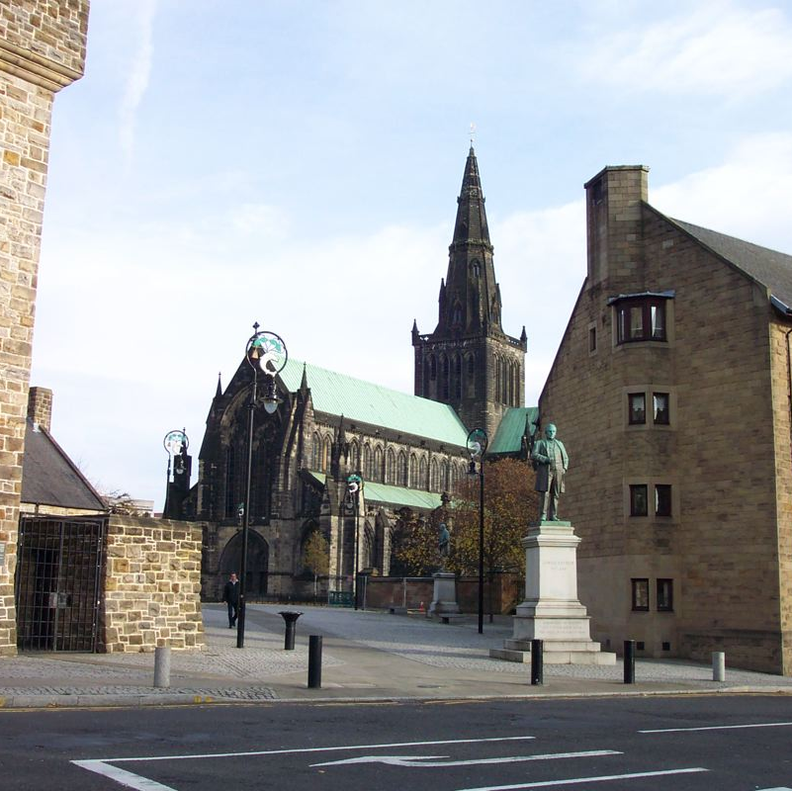
The Church of Scotland (Presbyterian) In Thomas Campbell’s Day = Divided
Old Light vs. New Light = controversy concerning discerning the laws of the Westminster Confession of Faith & that people should be amenable to “new light” from Scripture.
Seceder vs Anti-Seceder – Seceders could pick their own ministers – Anti-Seceder had high church appointments.
Burgher vs. Anti-Burgher – In 1747 Presbyterians separated over Burgher control - “Burgess” of a city – like a mayor of sorts – essentially the Sherrif
Glasgow Cathedral
Church of Scotland
“Presbyterian”
Notes:
Digression in the Burgher movement - 1747
a. Over whether the burgesses of the Scottish cities could swear to support the established churches or not.
b. burgess = magistrate or governor of a borough (burgh), city leader, or church father = like a mayor.
c. Thus, a mayor could decide for the city if the city would be a Seceder Church or Anti-Seceder Church.
d. The General Associate Synod was known as Anti-burgher and the Associate Synod was known as Anti-Burgher - 1749

Slide 13
The Church of Scotland (Presbyterian) In Thomas Campbell’s Day = Divided
Seceder Burgher Presbyterian
Seceder Anti-Burgher Presbyterian.
Anti-Seceder Burgher Presbyterian
Anti-Seceder Anti-Burgher Presbyterian.
Add Old-Lights & New-Lights to the equation and “a real mess.”
Glasgow Cathedral
Church of Scotland
“Presbyterian”

Slide 14
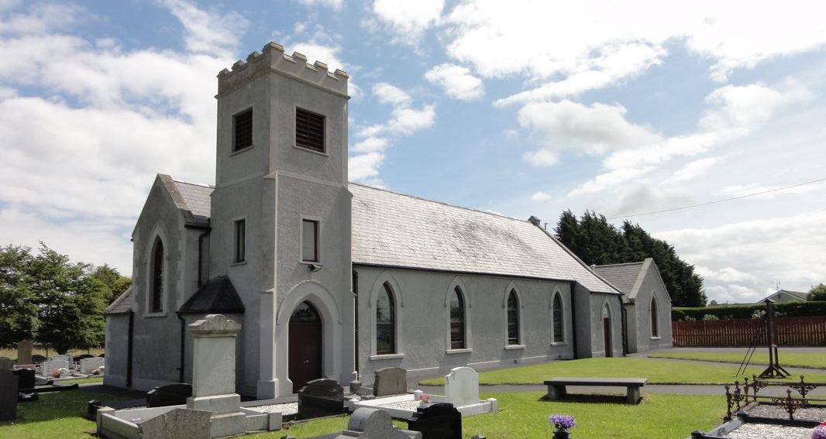
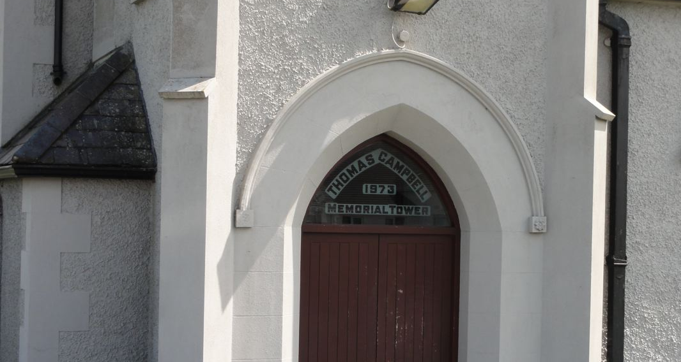
1798-1807 - Thomas Campbell is Pastor of Ahorey Presbyterian Church, Rich Hill, Ireland
An Old-Light, Anti-Burgher, Seceder Presbyterian Church
So, Strict adherence to Westminster Confession of Faith
Against control of town burgher, “mayor”
Picked their own minister

Slide 15
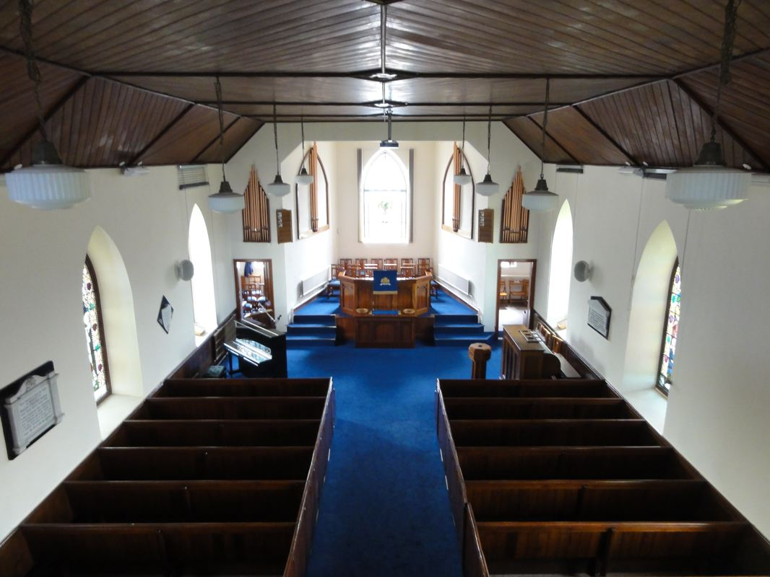
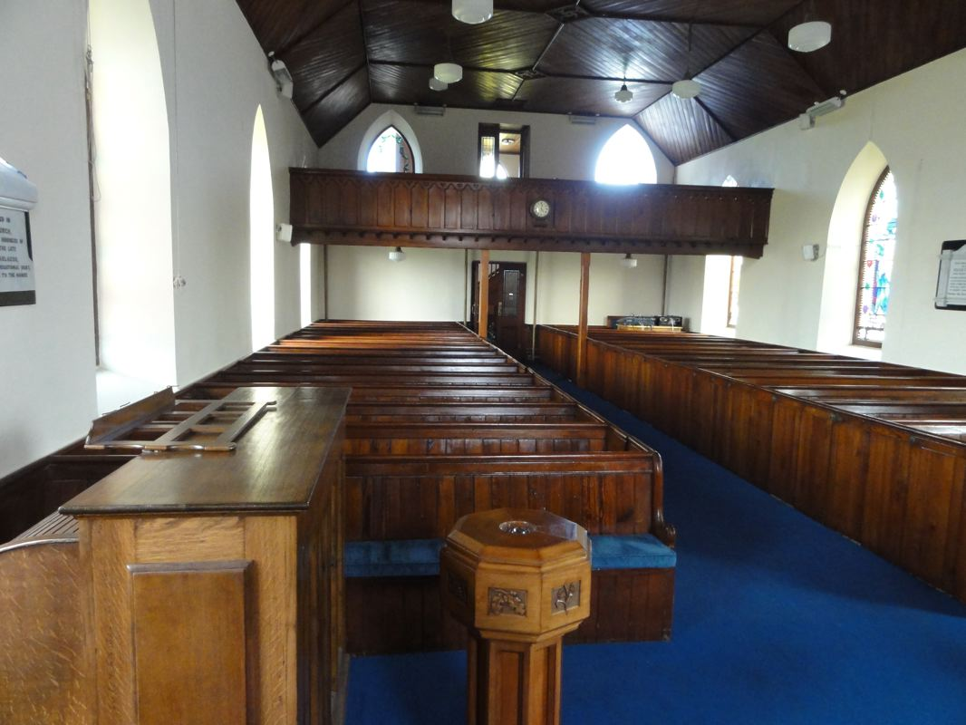
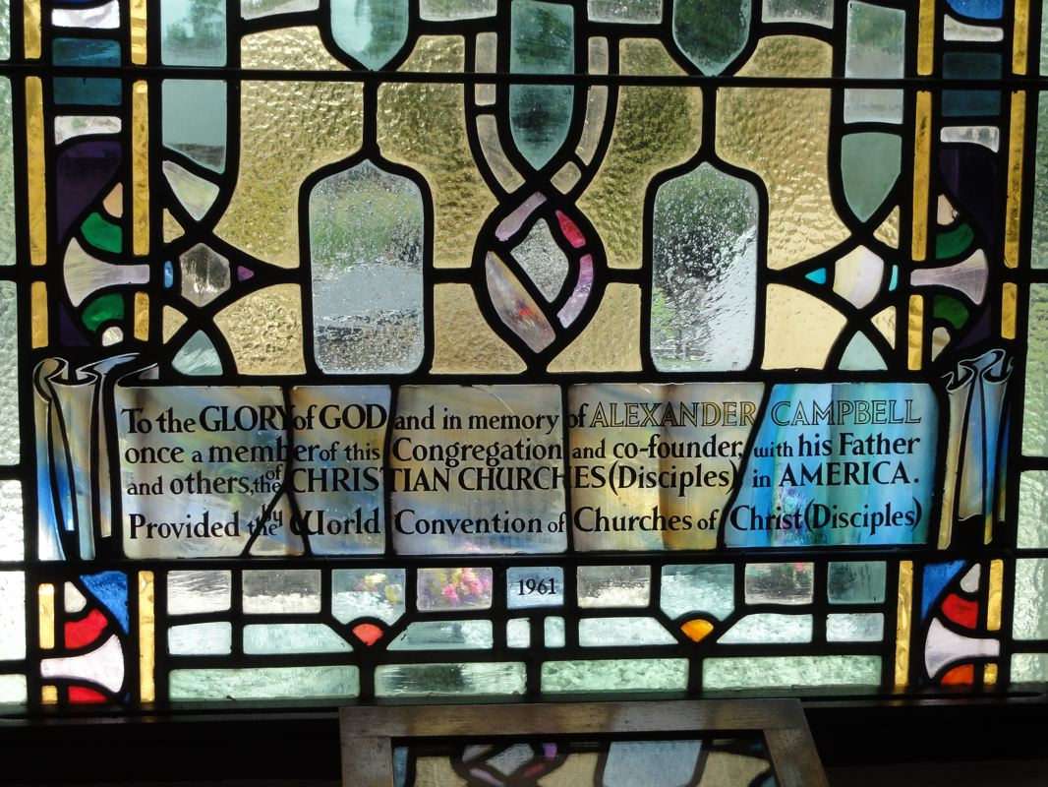
Ahorey Presbyterian Church, Rich Hill, Ireland

Slide 16
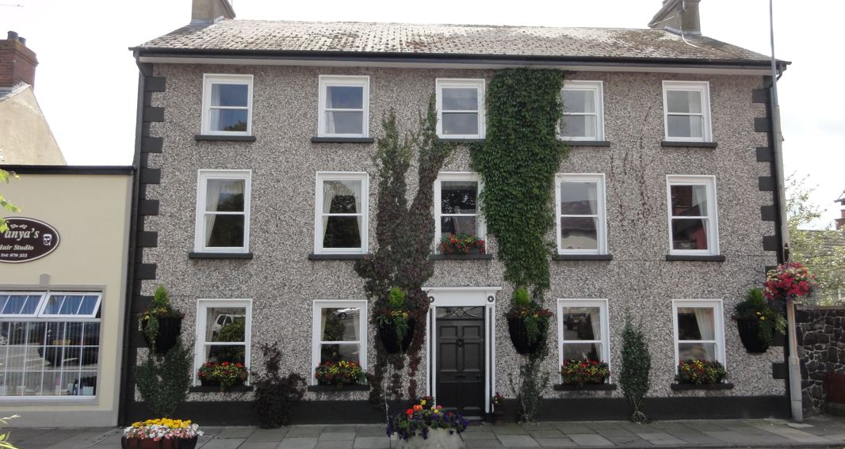
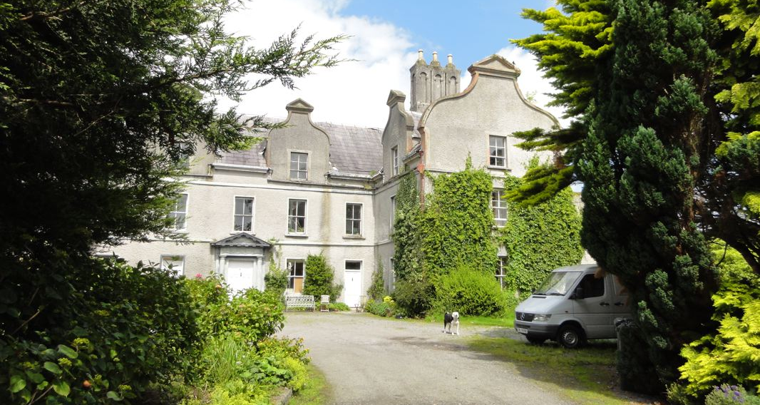
1798-1807 Rich Hill, Ireland
Thomas & Jane Homeschooled their 9 children & other children
1803 – The Puritans (Independents) paraded preachers: Rowland Hill, Alexander Carson, John Walker, & James Alexander Haldane
Thomas joined a missionary group called Evangelical Society, (Mem. Of A.C. v.1,p59
1807 Alexander was personal tutor to Lord Richardson’s children of Rich Hill Manor
Rich Hill Academy & Campbell Home
Rich Hill Manor (Castle)

Slide 17
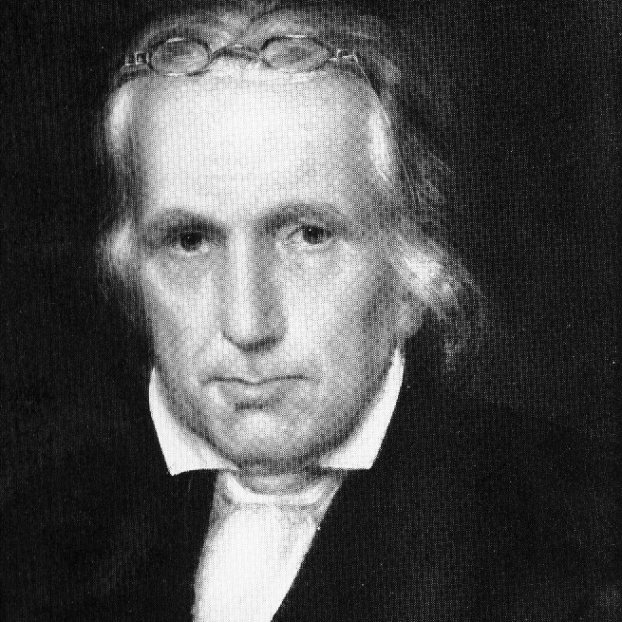
1807 To America
Notes:
To America – He is 46 years old! – The Winter of 1806-07 was horrible.
1. After several years spent in teaching at Rich-Hill, the excessive labor and confinement to which his father was subjected in fulfilling his duties to the congregation and to the school began seriously to impair his health. He grew extremely pale, dyspeptic (indigestion) and debilitated, and finally, after having for a long time tried various remedies in vain, he was informed by his physician that his life would be the forfeit if he persisted in continuing his unremitting mental toil; and that an absolute change of present pursuits, and such relief as [78] a protracted sea-voyage might afford, were indispensably necessary to his recovery. – Memoirs, v.1, p.77,78
2. Departed April 1, 1807 on the sailing-vessel Brutus.
3. Arrived at Philadelphia May 13, 1807.
4. Came to settle in Washington, Pennsylvania, western part of state, about 20 miles from present day Bethany.
F. Among The North American Presbyterians for two years.
1. Taught & Preached beginning in July, 1807.
2. Not long before troubles with the Presbyterians.
a. Sent on a preaching trip to a small group of Anti-Burgher Presbyterians up the Allegheny River, prob. a two or three day trip.
b. Because different kinds of Presbyterian people were in the area, and there was a preacher, all different kinds of Presbyterians came to the service.
c. He didn’t have the heart to deny any of the people the right to the Lord’s Supper even if they weren’t in full fellowship with the Anti-Burgher Presbyterian Church.
d. Also he had preached for some churches that simply asked him to come preach, WITHOUT PERMISSION!!!!!!!!!!
3. Called before the Chartiers Prebytery for it in October 27, 1807. Between Oct and May of 1809 several
a. In May, he sent a form of the Declaration & Address to the Chartiers Presbytery appealing for a return to the Scriptures.
4. May 23, 1809 he severed from his relationship with Associate Synod of North America by the Synod. – at age 46.
G. He and a few others established the Christian Association of Washington
1. Not really a new church.
2. An independent effort to unite scattered Presbyterians on the basis of the Bible.
3. Just an association of Christians to study, teach and worship.

Slide 18
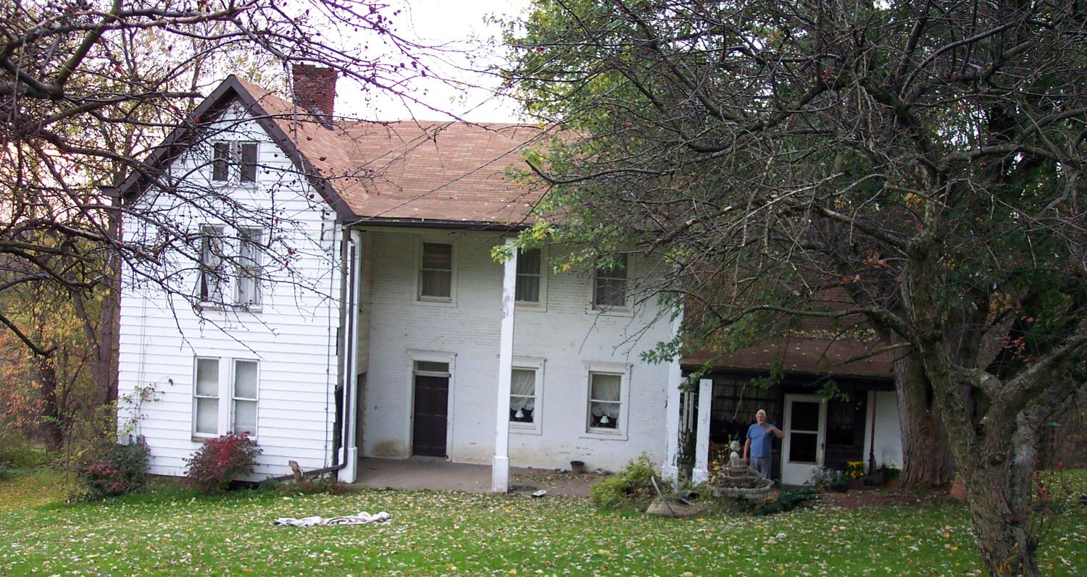
Washington, Pa. The Home Of The Declaration & Address Summer, 1809
”Prophet’s Chamber” upstairs in farmhouse of Mr. Welch

